Slide 1
Group 47 - WebPhysicsVR
Fall 2018 Progress Report
CS Capstone 2018-2019
Jonathan Jones Evan Brass
Brooks Mikkelsen Tim Forsyth
Brandon Mei

Slide 2
Introduction
Goals
Enable students with inexpensive hardware to learn through experiments that are usually:
Expensive: (ex. Vacuum Chamber equipment)
Otherwise impossible: (ex. Visiting another planet, visualizing velocity vectors, etc.)
Demonstrate the WebXR API’s potential
By being open Source (Intended deployment at Intel’s 01.org)
Design
We want the experience to reflect what doing the actual experiment would be like.
In VR tools / Equipment, Experimental procedure in VR.
Progressive Enhancement:
Swap capabilities (touch, pointing controllers, hand tracked controllers, etc.) in as they are available but keep baseline required functionality small.

Slide 3
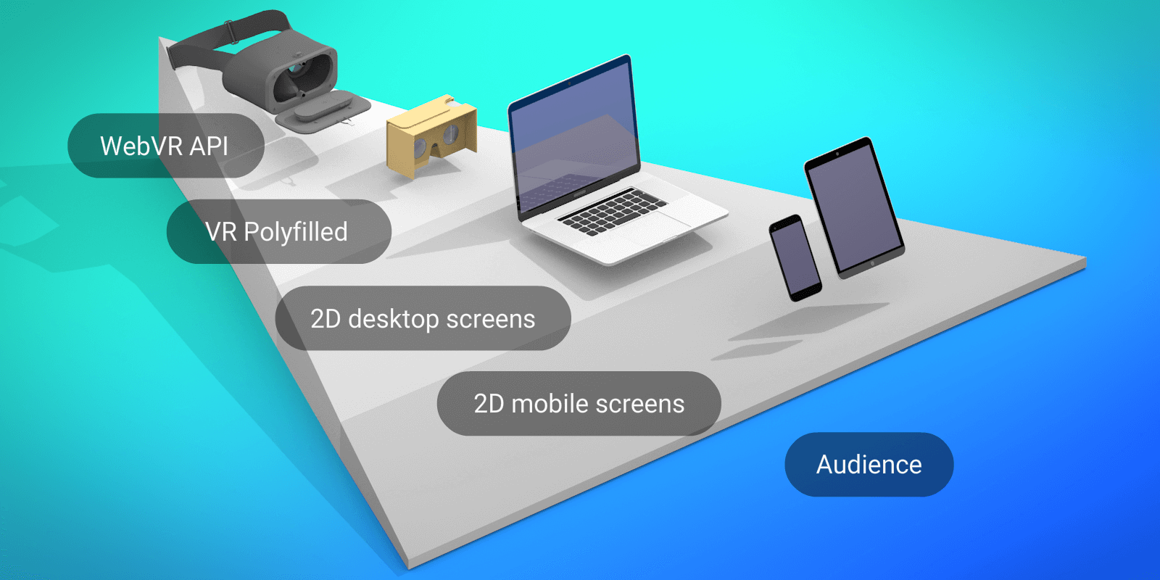
What is WebXR?
Open source JavaScript API for interfacing with virtual/augmented reality devices
Built on the previous WebVR API
Massively popular
No AR support
Built by the Immersive Web Community group
A coalition of various tech companies working together to deliver a working VR experience to the web
Able to deliver VR/AR applications through desktop and mobile browsers
https://cdn-images-1.medium.com/max/2000/1*RSFdu323kySX-0mVw-cAcg.png

Slide 4

Our Project - WebPhysicsVR
Physics Simulation
Interactive VR
Educational
Pre-built experiment stations
Accessibility
Desktop
Head Mounted Displays
Mobile devices
Showcase WebXR capabilities
https://fortunedotcom.files.wordpress.com/2015/12/oculus-touch.jpg

Slide 5
What we’ve done so far
Key events
Week 3: Met with the client, Alexis Menard, at Intel Hillsboro and brainstormed project ideas
Week 4: Drafted the Problem Statement
Week 5: Selected a physics simulation as our project
Week 6: Drafted the Requirements Document
Week 7: Individually wrote Tech Reviews
Week 8: Design Document brainstorm
Week 9: Met with Alexis in Corvallis to further go over expectations
Week 10: Drafted the Design Document
Future Plans
Decide which experiments to recreate
Begin implementation

Slide 6
Technical Design: Research & Selection

Slide 7
Simulation Components

Slide 8

Physics - Cannon.js
var world = new CANNON.World(); world.gravity.set(0, 0, -9.82);
Simulation needs a physics backend
Animates scene in a realistic way
Supports user interaction
Cannon.js
Lightweight 3D physics engine
JavaScript
Open Source
Feature heavy
Well documented
Cannon.js Features
Rigid body dynamics
Discrete collision detection
Contacts, friction and restitution
Constraints
PointToPoint
Distance
Hinge
Lock
Collision filters
Body sleeping
Various shapes and collision algorithms

Slide 9

Graphics - Three.js
var scene = new THREE.Scene(); renderer.render(scene);
WebGL
Communicates with GPU on the client to render 3D scenes onto a webpage
Three.js
Framework for WebGL
Abstracts the graphics process for web developers
Can be used in conjunction with HTML5 canvas elements
Compatible with most modern browsers
Falls back to older renderers if needed
Feature heavy
Built in support for WebVR API
http://www.skytopia.com/project/fractal/mandelbulb.html
Code rendered 3D approximation
of Mandelbrot set by Daniel White

Slide 10

Audio - Howler.js
var sound = new Howl({; src : [‘sound.mp3’]
}); sound.play();
WebAudio API
Developed by W3C
The standard for audio delivery on the web
Built into all modern browsers
Spatial Audio
Stereo speaker manipulation
Virtual sound placement in 3D
Fundamental to VR applications
Howler.js
Abstracts the WebAudio API
Built in support for spatial audio
Supports all audio file types
Auto Caching
https://d1muf25xaso8hp.cloudfront.net/https%3A%2F%2Fs3.amazonaws.com%2Fappforest_uf%2Ff1511101808452x248499521985650050%2Fhowlericon.png?w=96&h=96&auto=compress&dpr=3&fit=max

Slide 11
Interfaces

Slide 12

User Interface - Visuals
VR puts limitations on UI
Cannot be an overlay of the screen (non-diegetic)
Users too close to screen
Unable to be clearly read
Instead, should exist within the environment (diegetic)
Easier to read
Can move around it and interact with it better
Non-Diegetic
What is normally associated with UI
On the forefront of the screen
Might be some sort of overlay
Diegetic
Instead of being on the front of the screen, it exists within the environment
The UI is an object that is interacted with in a different way
https://cdn-images-1.medium.com/max/1600/1*NNF8ZCnBe_0OFF2xyjvF4w.png
Example of diegetic UI in Horizon Zero Dawn

Slide 13
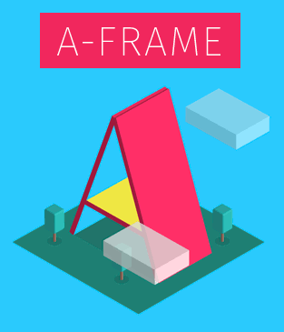
User Interface - Visuals
three.js
Make use of two tools: Three.js and A-Frame
Three.js
Graphical API
On top of WebGL
Geometries
PlaneGeometry
A-Frame
Framework over Three.js
Primitives
Pre-built default objects
<a-box>
<a-plane>
<a-text>
https://upload.wikimedia.org/wikipedia/commons/9/92/A-Frame_logo.png

Slide 14
User Interface - Function
Interactive functionality
Perform requested actions
Event handling
A-Frame
Components
Modular chunk of data that can be “plugged into” an object
Can effect appearance, behavior or functionality
Unique properties
schema
Defines and describes the properties of the component
Functionality can be implemented here
JavaScript event handling
data
The parsed data derived from the schema
el
A reference to the object

Slide 15
Hardware Interfacing and Performance

Slide 16
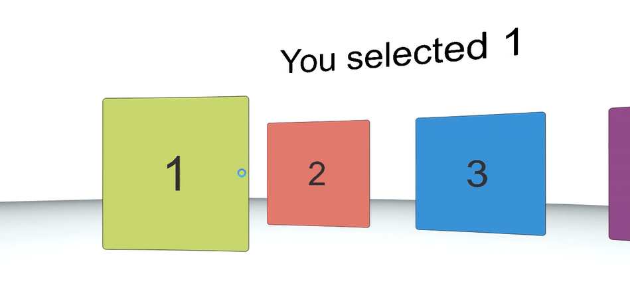
Hardware Interfacing
Support a wide variety of devices
VR HMD
Laser control
Scales well across different DoF
Mobile HMD
Google Daydream
Gaze based interaction
Reticle with timer
“Fuse” buttons
PC
Mouse and keyboard controls
Mobile
Touchscreen controls
https://cdn-images-1.medium.com/max/1600/1*GKEpJSD76WQAhjA6wMaMUQ.gif
A demo showing an implementation of a gaze based input

Slide 17
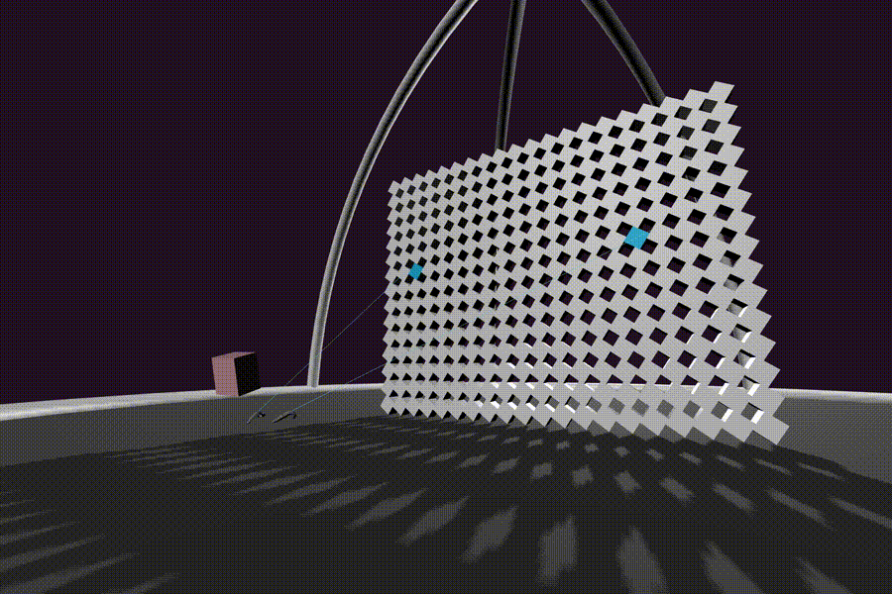
Hardware Interfacing
WebXR API
Hardware detection
Gamepad API - built in support
Allows for basic controller setup
Gamepad API Extensions
Includes VR controller positional tracking
A-Frame
Useful, pre-built components
look-controls
Camera rotation
Supports HMD, mouse and touchscreen
laser-controls
Pointer/wand based control scheme
Supports Oculus, VIVE, Daydream, GearVR
wasd-controls
Keyboard control scheme
cursor
Hover and click state
Laser controls being used in a VR demo
https://user-images.githubusercontent.com/674727/26897482-91947a94-4b7d-11e7-9cb5-5c47f50938e4.gif

Slide 18
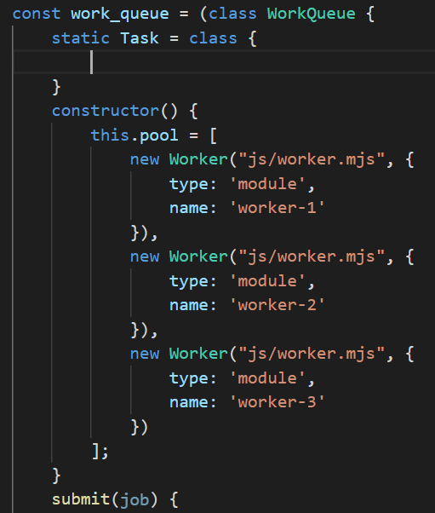
Avenues for performance
Rust + WebAssembly: Performance critical computation
Workers: Keeping the main thread responsive
Detecting + Managing Lag
Monitoring frame rate + checking for Idle CPU Cycles.
Tier assets - Use responsive image loading.
Cache Management + Efficient Loading
Service Worker: Offline Use + Cache priming
Meta elements with preload/prefetch/preconnect: Parse time asset hints
Lazy Loading ECMAScript Modules + Precompile WebAssembly Modules and share them across workers

Slide 19
Web Hosting Services

Slide 20



Web Hosting
Options
Glitch
GitHub Pages
Surge
Our Choice GitHub pages
Static site hosting service directly from a GitHub repository.
Deliver the user exactly what is stored.
Repository name plus github.io format.
Personal URL that is tied to GitHub account.

Slide 21

Hosting Assets/Models
Option hosting assets by Content Delivery Network
A-Frame Asset uploader
Glitch Asset uploader
Our choice Hosting Models
GitHub repository
Upload our assets to GitHub repository
Serve the model files

Slide 22

Version Control System
GitHub
Features
Code review and documentation.
Project management
Code hosting.
Integrations with CircleCI.
3D render files that can be preview using STL file viewer.
https://media.xconomy.com/wordpress/wp-content/images/2016/06/06161811/github-logo.jpg

Slide 23
Project Setup
Notes:
We made several design decisions related to the project setup and our build process.
we chose a language to write our app in
we also chose a tool to compile our assets together,
and then we chose a continuous integration tool to build and run our tests

Slide 24



Language
Options:
Plain ES2018 JavaScript
TypeScript
Flow
Our choice: TypeScript
Compile-time type checking helps prevent errors
Refactoring and intellisense
Simple syntax
Widespread support
Notes:
several options for the client side language to build our app in. only absolute requirement is that the one we pick needs to compile down to an older version of javascript that is compatible with most browsers.
Plain ES2018 JavaScript - the latest standard version of JavaScript for the web.
TypeScript - provides static typing on top of JavaScript, refactoring, and intellisense.
Flow - alternative to TypeScript that focuses more on deep understanding of code, not quite as popular as typescript so smaller libraries do not have type definitions for flow.
Our choice is typescript
Compile-time type checking helps prevent errors
Reduces issues stemming from accidental type coercion improperly accessing data
refactoring and code navigations will speed up our coding experience by a lot.
code suggestions and completion from intellisense will keep us from having to go back and look up the structure of data while coding
TS follows JavaScript syntax exactly, with added type annotations
we will be able to use the latest javascript features in ES2018 as well
Widespread support
all of the libraries and modules we want to use have ts definitions, except for webxr because its so new

Slide 25



Asset Bundler
Options
Webpack
Parcel
Rollup
Our choice: Parcel
No configuration
Support for TypeScript, Rust
Development server and code splitting
Notes:
asset bundlers determine the dependencies of a webpage and package them together to make sure that everything that is needed gets loaded at the right time.
also several options for asset bundlers.
webpack is the industry standard and has been for a few years. It has lots of customization, but it is somewhat complex to get set up and running the way you want. There is good documentation to follow for setting everything up though
Parcel is newer, and requires no configuration to get useful tools set up such as a development server with hot module replacement and code splitting to control when portions of the code load.
Rollup is another new asset bundler. its somewhat simpler to configure rollup than webpack, but the documentation is not quite as good and there is not as much support for it. It does seem to be faster than the other two options.
our choice is parcel, because its so simple to get running.
It doesn’t have the same amount of control over its features that webpack has, so if we need more control, we can switch to webpack since they both have the features we need
parcel has support for typescript and rust files right out of the box, which will be helpful so we don’t have to spend time configuring that.
it also has a development server that watches for changes in source files, and then automatically builds and reloads the page, so you see the latest changes without having to do anything
The code splitting feature that comes built is also going to help optimize the load times for our app since it will have so many 3d objects and textures that need to be loaded

Slide 26



Continuous Integration
Options
Circle CI
Travis CI
Jenkins
Our choice: Circle CI
Simple YAML configuration
Free for open source projects
Simple to hook into GitHub
Fast queue and build times
Notes:
Continuous integration helps developers make sure the code they are committing builds without errors, is up to any style standards, and still passes all of the unit tests
we picked three options to compare and choose from
circle ci is a popular CI service that is hosted on the cloud and easily configurable with pretty good documentation and examples on how to set everything up. it’s free for open source projects, and can hook into github.
travis ci has pretty much all of the same features circle CI has, with the added bonus of being able to build and test the project on multiple platforms and versions. It’s a little bit slower than circle ci, however. It’s also free for open source projects
Jenkins is a free server application that runs on a dedicated build server. like circle ci and travis, jenkins can be configured to build, test, and deploy an app.
We chose circle ci for a few different reasons
there’s easy configuration, and lots of tutorials for basic build and test setups like we would need
it’s free for open source projects, and we wouldnt need to set up a dedicated build server for our project since it runs in the cloud
it can be setup to hook into github so that the CI service gets run after every push to a branch and before every pull request gets merged
its faster than travis, and since we’re going to host the app on github pages, we don’t need to test it on platforms.

